Slide 1
Static Analysis and Unit Testing –
Why Bother?
Software Test and Performance
November 2006, Cambridge, MA
Sergei Sokolov

Slide 2
Outline
Why: Economic case for best practices
What: Sensible best practices that work
How: Applying and automating best practices
  Coding standards / static analysys
  Code reviews
  Unit and regression testing

Slide 3
Best Practices – why do we care?
Write production code faster
Avoid rework
Avoid 11th hour rush
Spend less time fixing bugs
Learn from someone else’s mistakes, not your own
Be proud of your code that works

Slide 4
Quality and financial impact
NIST study in 2002 found that:
  Software bugs are costing US industry ~$60B/year
  60,000,000,000
  Users incur 64% of cost, developers 36%
  Improvements in testing could reduce this cost by about a third, or $22.5 billion
Shortest development schedules are correlated with high-quality software (target 95% defect-free code)

Slide 5
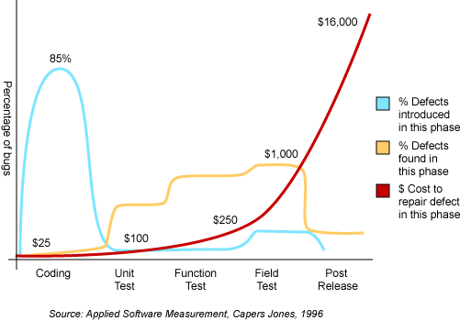
Where is the cost of bugs?

Slide 6
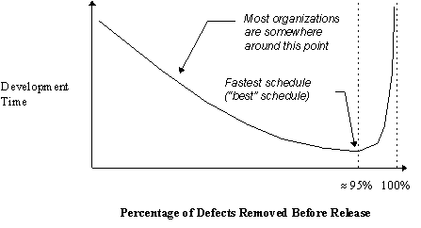
Fewer bugs or shorter schedules?
Source: Jones, Capers. Applied Software Measurement: Assuring Productivity and Quality.

Slide 7
Bugs – Security angle
Gartner
  75% hacks happen at the application level
NIST
  92% vulnerabilities are at the application level, not network
Theo de Raadt, OpenBSD
  “… probably 95% of security problems that happen in software are low-level programmer errors.”
Alan Paller, Director of Research SANS Institute
  “… everything on the [Top 20] vulnerability
  list is a result of poor coding, testing, and
  sloppy software engineering.”

Slide 8
Testing becomes harder
Increased complexity of modern software systems
Increased complexity of interaction in distributed teams with uneven skill level
Almost continuous development with worldwide locations
Changes to code can break previously functional components
Non-reproducible tests
Lack of record keeping

Slide 9
What is the development time spent on?
Specification – 40%
Actual coding – 10%
Testing – 50%
  (actual quote from a large customer >1000 developers)

Slide 10
W. Edward Deming:
“Quality comes not from inspection,
but from improvement of the
development process.”
Benjamin Franklin:
“ An ounce of prevention is worth a pound of cure.”

Slide 11
Let’s define terms (Merriam – Webster online)
Error (noun)
  1 a : an act or condition of ignorant or imprudent deviation from a code of behavior
  …
  5 : a deficiency or imperfection in structure or function
Prevent (verb)
  …
  3 : to keep from happening or existing
  implies continuously taking advance measures against something possible or probable

Slide 12
What can we do about the cost of bugs?
Simple Testing Problem
Immediate Causes of Bugs
Interface / Application Layer
Implementation Layer
Complex Testing Problem
Symptoms not Bugs

Slide 13
From Top Ten Defect Reduction List by Boehm/Basili 2001
Finding errors earlier is 5:1 to 100:1 less expensive
  Good architectural practices can reduce cost-escalation factor
Reduce avoidable rework
  Effort spent fixing issues that could have been discovered earlier
Peer reviews catch on average 60% of defects
  Perspective-based (focused) reviews are 35% more effective
Disciplined personal practices reduce defect rate by 25 - 75%
  Root cause analysis of defects
  Developing personal checklists and practices
  Gets even better when scaled up to the team

Slide 14
Top Ten List – (ctd.)
Test more, test often
  In 25 – 50% of cases, testing 3rd party or open source code reveals bugs (anecdotal evidence)
  40-50% of user programs contain non-trivial defects
Quality is free… Is this so?
  Costs 50% more per instruction to develop high-dependability software than low-dependability
  High-dependability SW costs 15% less to maintain than develop
  Low-dependendabilty SW costs 50% more to maintain than develop

Slide 15
Best development practices
Knowledge, tools, and methods that help prevent errors in development cycle:
  Automated builds
  Automated static analysis
      Coding standards
      Complexity analysis
      Dataflow analysis
  Code reviews / Inspections
  Automated testing
      Unit testing
      Functional testing
      Regression testing
      Code coverage analysis

Slide 16
Coding Standards – what’s in a name?
Goal – find any errors you can, cheap
Possible bugs and “gotchas”
Application-specific guidelines
Enforce security policy
Specific application development models
Readability
Better maintainable code

Slide 17
Error Prevention by Coding Standards
Somebody else already stepped on the rake:
  Leverage best known practices
You stepped on the rake:
  Create a custom coding practice to prevent a repeat
You suspect the rake may be right there…:
  Steer left (defensive programming)

Slide 18
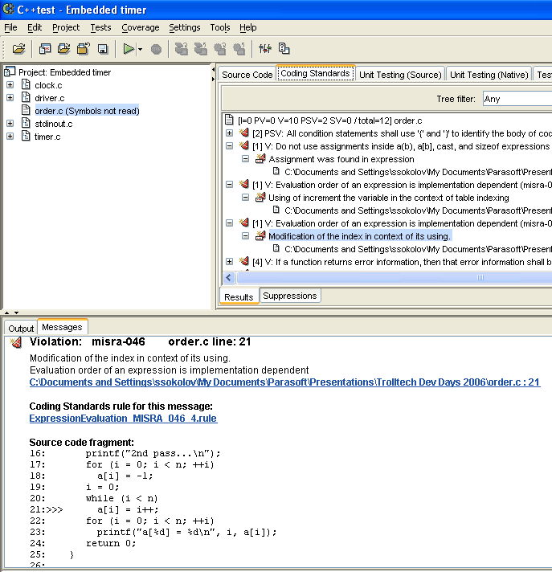
Example 1: Order of evaluation
#include <stdio.h>
int main()
{
enum { n = 3 };
int a[n];
int i;
printf("1st pass...\n");
for (i = 0; i < n; ++i)
a[i] = -1;
i = 0;
while (i < n)
a[i++] = i;
for (i = 0; i < n; ++i)
printf("a[%d] = %d\n", i, a[i]);
printf("2nd pass...\n");
for (i = 0; i < n; ++i)
a[i] = -1;
i = 0;
while (i < n)
a[i] = i++;
for (i = 0; i < n; ++i)
printf("a[%d] = %d\n", i, a[i]);
return 0;
}

Slide 19
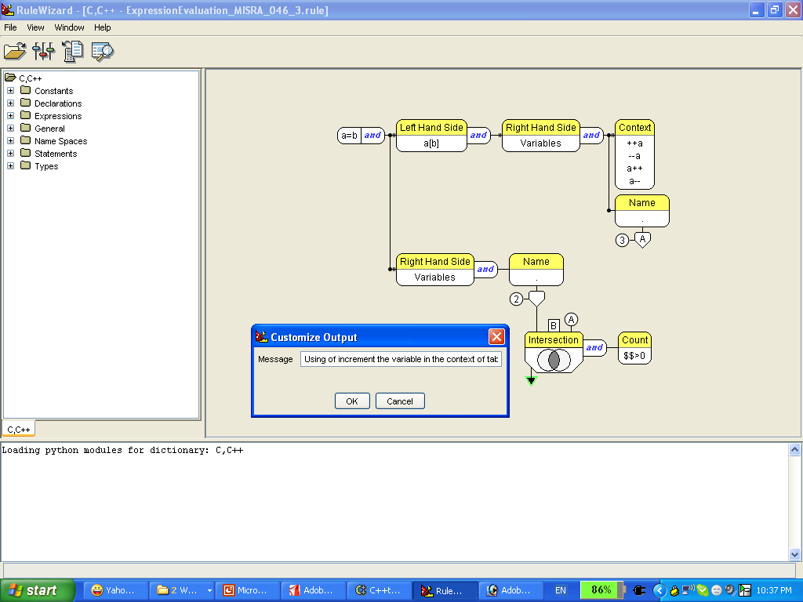
Static rule from Parasoft RuleWizard

Slide 20
Example 2: Closing Resources
public void execute() throws SQLException {
Connection con = getConnection();
  try { // assume the connection is created here Statement stmt = con.createStatement();
  // ....
  con.close();
  }
  catch(SQLException e) { e.printStackTrace();
  }
  // VIOLATION : missing 'con.close()' in finally block
}

Slide 21
Example 2: Closing Resources
public void execute() throws SQLException { Connection con = getConnection();
  try { // assume the connection is created here Statement stmt = con.createStatement();
  // ....
  }
  catch(SQLException e) { e.printStackTrace(); }
  finally {
    if (con != null && !con.isClosed()) { con.close(); // FIXED
    }
  }
}

Slide 22
Static Analysis – Available industry-wide knowledge C++
Scott Meyers’ Effective C++ and More Effective C++
Sutter and Alexandrescu C++ Coding Standards
Ellemtel standards
Dan Saks “C/C++ Gotchas” series
Stephen Dewhurst “C++ Gotchas”
Portability (32 to 64 bits)
MISRA (including 2004)
Notes:
Static analysis with C++test is based on built in rules, and can be extended with custom rules. C++test comes with more than 700 built in rules, which form the basis for a coding policy implementation. We implement such well known industry standards as Scott Meyer’s Effective C++ books, the new book by Sutter and Alexandrescu with 101 C++ Coding Guidelines, and others listed here. We now have added 17 rules with best practices for Qt usage, which we codeveloped with Trolltech. This set of rules is available now as part of the standard C++test distribution with version 6.7.3.

Slide 23
Static Analysis – Custom Rules
Isolate a bug that you found, create a rule, look for other cases
Framework-specific rules (Qt, ACE, Struts, etc)
Application- or project-specific rules
Use custom rules to:
  Check for instances of known bugs
  Enforce proper use of the APIs and data structures
  Standardize use of comments, copyright headers, etc.
Notes:
In addition to the large set of built in rules, C++test contains a powerful graphical rule editor that can be used to modify existing rules or create custom ones. Rules can be created by stitching together language elements in a graphical viewer, much like in PowerPoint or VISIO, or by pasting a snippet of code, that the editor automatically converts to an editable representation. The rules can include operators for set collections, intersections, etc, message nodes, and can also be extended by Python scripting. All these degrees of freedom enable users to easily create rules depending on the need, such as checking for other instances of detected bugs, enforcing appropriate usage of an API or datastructures, or just standardizing use of comments and other text in the file.

Slide 24
A Case for Coding Conventions
Software is executable knowledge
Capture knowledge in a form readable by others
Somebody else other than a compiler will be reading your code!
Leverage implementation from knowledge of others
Use self-documenting code

Slide 25
Implementation and automation
Define a coding policy
Create a rule set that implements the coding policy
Implement custom rules, as needed
Analyze code on desktop and correct violations before checking in
Run scheduled batch analysis on the entire code base
Collect and track violation counts to correlate with other application quality metrics
Update the rule set as needed
Notes:
To effectively implement and automate checking with C++test of a coding policy including Qt Best Practices, there are just a few steps:
First obviously you need to define the policy, or the rule set, and create the appropriate rule configuration in C++test. Depending on the policy, implementation of some custom rules may be necessary. This configuration will be made available, automatically, to all C++test users, through Parasoft’s Team components.
With thus set up configuration code should be analyzed on the desktop prior to checkin in, and rule violations cleaned up at that stage. On the other hand, scheduled batch runs on the entire code base should be put in place for consistent sanity checks and regular reports. Reports from the batch runs should be analyzed for any remaining violations, and trending with respect to other quality metrics.
Finally, the rule set should be updated according to specifics of code and any new code issues that need to be prevented.

Slide 26
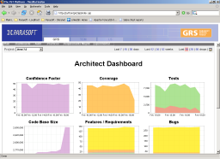

Team-wide Deployment and Workflow
code & tests
SCM
Source Control
Developer
Machines
Batch Mode
Analysis
Test Results
Scheduled Test
Server
Analytical
Dashboard
Program Manager
Architect
Professional Editions
Nightly
Results
TCM
Architect /
Technical lead
Team Configuration
Manager
Architect Edition
Team Coding
Standards

Slide 27
Critical Success Factors for
Application of Coding Standards
Apply guidelines before submitting to
source control (check-in trigger)
Apply uniformly across a development team
Automation and integration to development cycle is essential for adoption
Apply before the application is completed
Custom standards and standard configurations are key to continuous improvement

Slide 28
Peer Code Reviews
Born as Fagan inspections at IBM in 80’s
Known as one of the best techniques to catch bugs (also see Barry Boehm)
Generally suffer from inconsistencies, lack of follow-up, and high degree of induced boredom:
  Lack of consistent coding policies (“gut review”)
  Review time is spent mostly on validating conformance with coding policy, not algorithm/architecture/reuse
  Issues are not recorded
  Resolution of code review issues not tracked
  Hard to perform with distributed teams
Notes:
To effectively implement and automate checking with C++test of a coding policy including Qt Best Practices, there are just a few steps:
First obviously you need to define the policy, or the rule set, and create the appropriate rule configuration in C++test. Depending on the policy, implementation of some custom rules may be necessary. This configuration will be made available, automatically, to all C++test users, through Parasoft’s Team components.
With thus set up configuration code should be analyzed on the desktop prior to checkin in, and rule violations cleaned up at that stage. On the other hand, scheduled batch runs on the entire code base should be put in place for consistent sanity checks and regular reports. Reports from the batch runs should be analyzed for any remaining violations, and trending with respect to other quality metrics.
Finally, the rule set should be updated according to specifics of code and any new code issues that need to be prevented.

Slide 29
Automated implementation
Automatic static code analysis on desktop and in batch
Review code as close to check in as possible (early)
Create team associations with specific software modules
Review team receives automatic notification when code of their “associated module” is checked in
Comments are annotated against the code in IDE
Outstanding code review issues are tracked by the project dashboard
Notes:
To effectively implement and automate checking with C++test of a coding policy including Qt Best Practices, there are just a few steps:
First obviously you need to define the policy, or the rule set, and create the appropriate rule configuration in C++test. Depending on the policy, implementation of some custom rules may be necessary. This configuration will be made available, automatically, to all C++test users, through Parasoft’s Team components.
With thus set up configuration code should be analyzed on the desktop prior to checkin in, and rule violations cleaned up at that stage. On the other hand, scheduled batch runs on the entire code base should be put in place for consistent sanity checks and regular reports. Reports from the batch runs should be analyzed for any remaining violations, and trending with respect to other quality metrics.
Finally, the rule set should be updated according to specifics of code and any new code issues that need to be prevented.

Slide 30
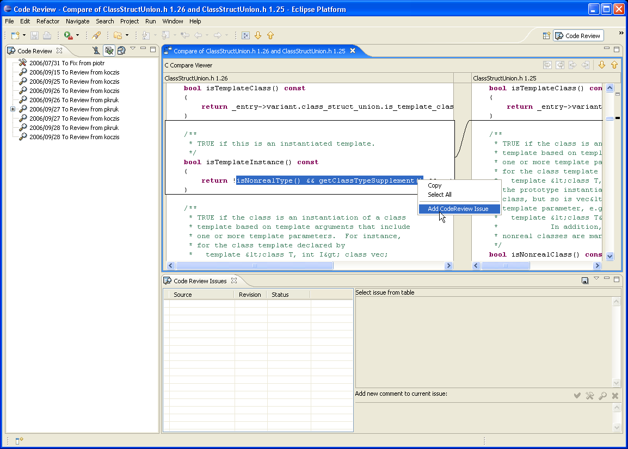
Code Review notification

Slide 31
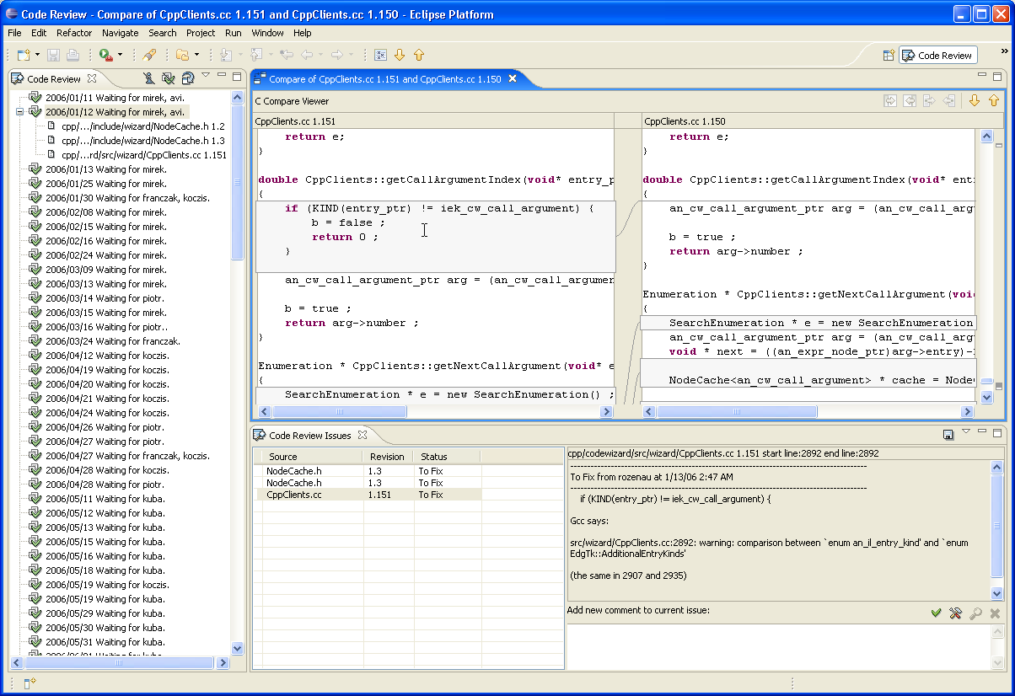
Pending Code Review Comments

Slide 32
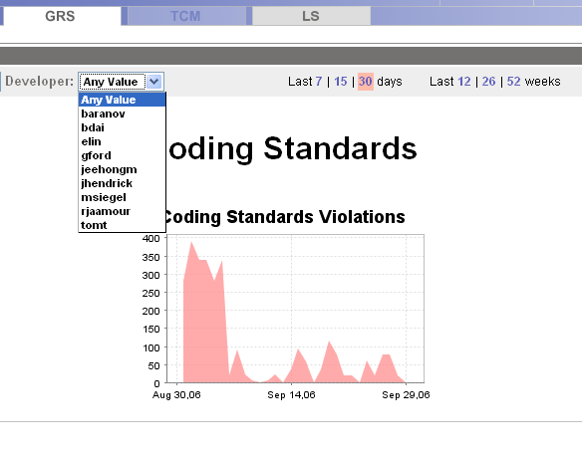
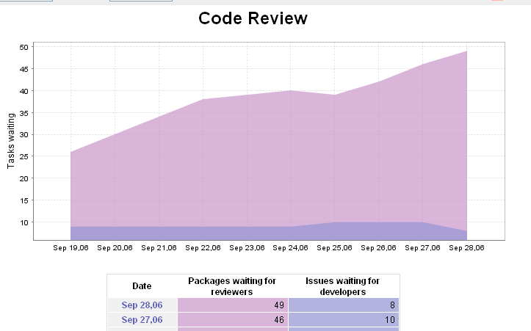
Process Monitoring

Slide 33
Unit Testing Revisited
A unit test is a procedure used to validate that a particular module of source code is working properly
Write test cases for all functions
Unit test cases should be used for / derived from specification of a function’s behavior
Unit tests can be thought of as executable specifications
Whenever a change causes a regression, it can be quickly identified and fixed
Types of unit tests:
  Black box / functional
  White box / coverage
  Use-case / scenario
  Negative / bad input

Slide 34
What makes up a unit test?
Infrastructure (test harness, test runner, runtime library, reporting engine, etc.)
Unit test is a (test) function that
  … sets up necessary data to
  … call one or more user code functions under test
  … and validates results of the call
Stubs
setUp/tearDown

Slide 35
Function Stubs
Allow testing of code when dependencies are not available
When original function definitions are not available:
  Automatic stubs – return safe value based on type (“just do something”)
  User-defined stubs – mock code if function not implemented or has complex behavior
Stubs provide extra control points in testing of code
Allow fault insertion into user-defined stubs to help with testing error conditions

Slide 36
Stubs: Removing External Dependencies
Test Case
External
Dependency
Test Method
Project Code
Class Under Test
Stub Method
Stub
Implementation

Slide 37
Code coverage
Measure of how well your tests exercise your code
Minimum level – statement coverage
Decision, condition, path coverage are really what’s needed for good measure
Assists in creating targeted unit tests
Existing standards for safety-critical systems mandate branch and condition coverage (DO-178B, CENELEC)
Graphical representation is critical for detailed analysis

Slide 38
Benefits of unit testing
Code can be tested before application is complete
Simpler to set up due to smaller state space
Simplify testing of error and exception handling at the function level
Reproducible
Can be shared among developers
Can be run as regression

Slide 39
Automation of Unit testing
Test generation
Test case management
Test execution / regressions
Report generation
Stubs generation / management / switching
Coverage analysis (bundled)
Source control

Slide 40
Controlling Impact of Change : regression testing
Why is it important?
  Development organizations need to ensure that code additions and changes do not break the previous verified functionally
  Provides a safety net for code changes and refactoring
What is required?
  All existing reliability and functionality tests should be regression tested on each new build of the application.
Simplifying the job
  Automated or continuous regression test suite
  Short feedback loop to developers
  Partition failure reports based on authorship of code or tests

Slide 41
Summary
Best practices result in higher productivity without added strain
Automation is key to success of best practices:
  Repeatability
  Consistency
  No bias
  Can be done in off-hours
Tools help greatly, but they are not the end in itself
Measure, control, and improve process

Slide 42

Questions…
Sergei Sokolov
ssokolov@parasoft.com

